Slide 1

CSE320: Data Communication
Chapter 5
Analog Transmission
Copyright © The McGraw-Hill Companies, Inc. Permission required for reproduction or display.

Slide 2
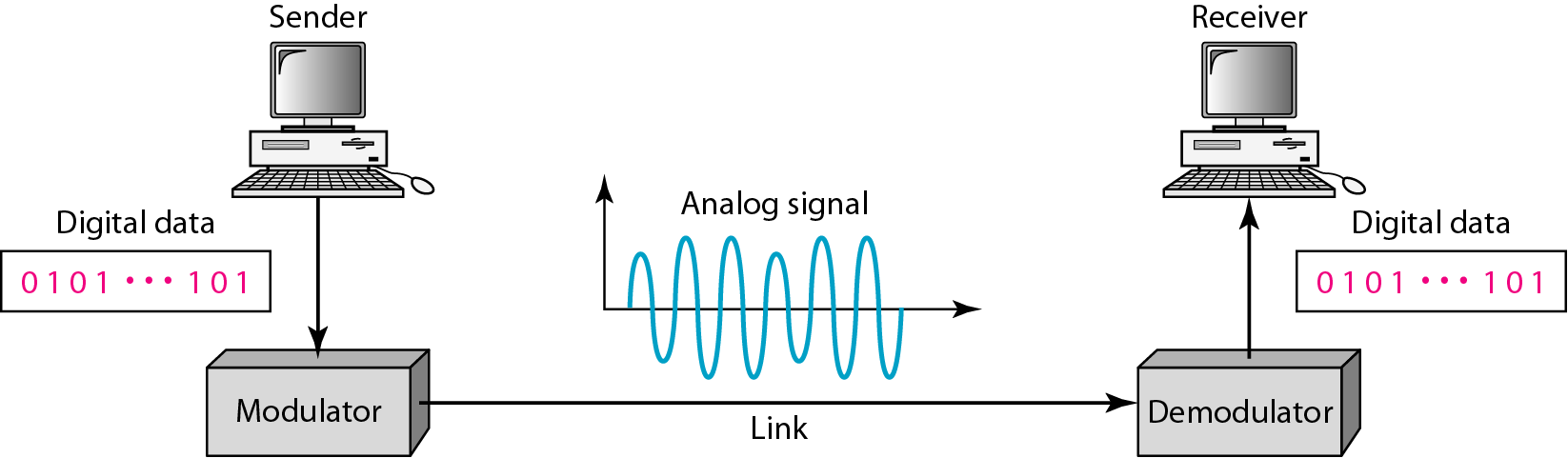
Figure 5.1 Digital-to-analog conversion

Slide 3
5-1 DIGITAL-TO-ANALOG CONVERSION
Digital-to-analog conversion is the process of changing one of the characteristics of an analog signal based on the information in digital data.
Topics discussed in this section:
Aspects of Digital-to-Analog Conversion
Amplitude Shift Keying
Frequency Shift Keying
Phase Shift Keying
Quadrature Amplitude Modulation

Slide 4
Digital to Analog Conversion
Digital data needs to be carried on an analog signal.
A carrier signal (frequency f_{c}) performs the function of transporting the digital data in an analog waveform.
The analog carrier signal is manipulated to uniquely identify the digital data being carried.

Slide 5
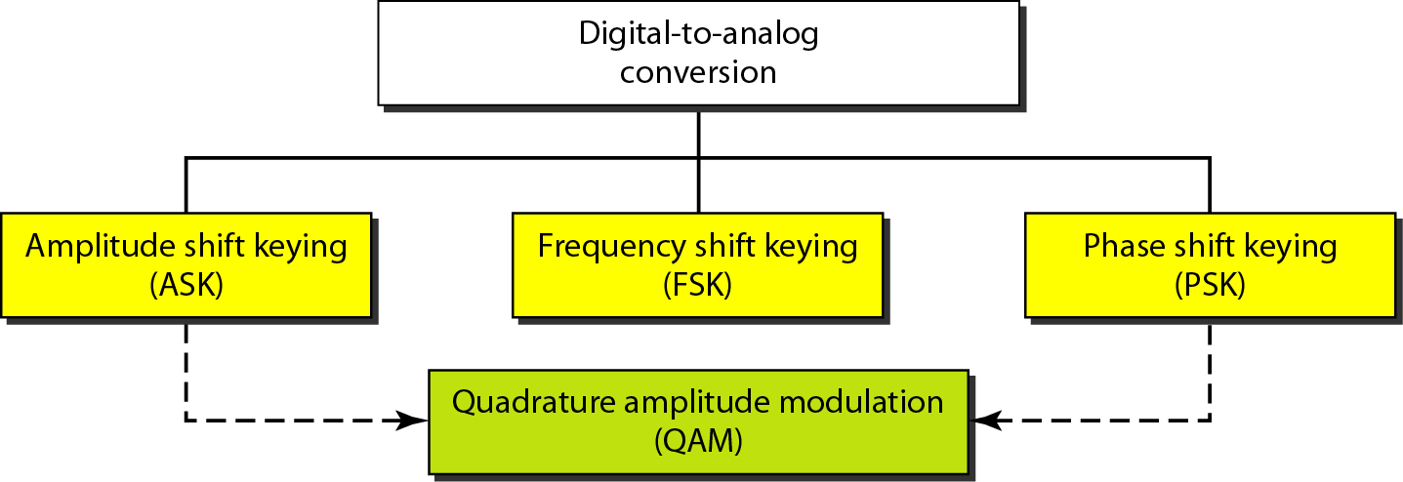
Figure 5.2 Types of digital-to-analog conversion

Slide 6
Amplitude Shift Keying (ASK)
ASK is implemented by changing the amplitude of a carrier signal to reflect amplitude levels in the digital signal.
For example: a digital “1” could not affect the signal, whereas a digital “0” would, by making it zero.
The line encoding will determine the values of the analog waveform to reflect the digital data being carried.

Slide 7
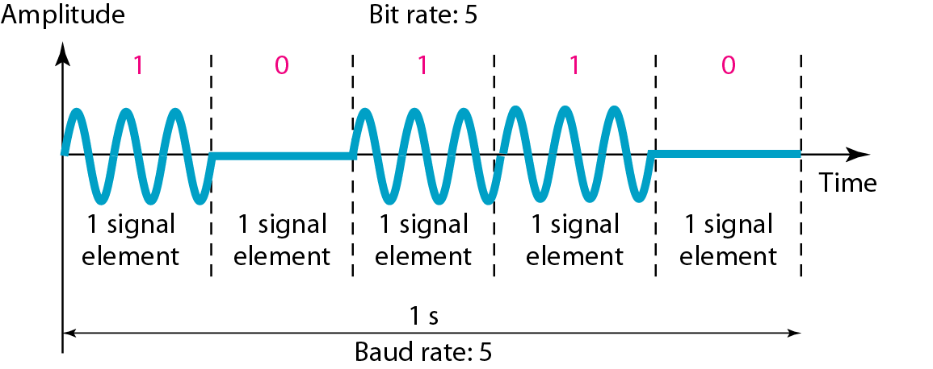
Figure 5.3 Binary amplitude shift keying
Also known as On Off Keying (OOK)

Slide 8
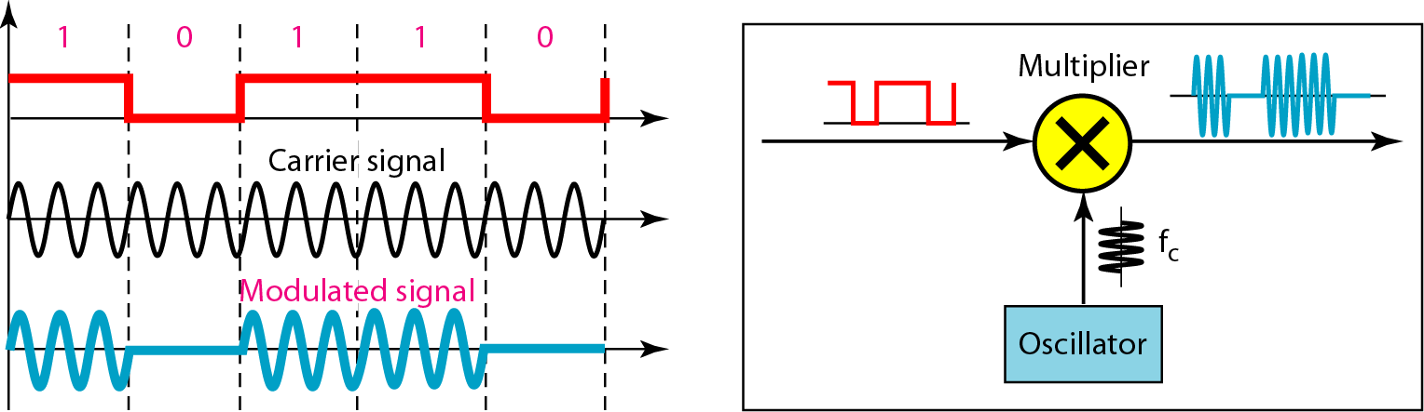
Figure 5.4 Implementation of binary ASK

Slide 9
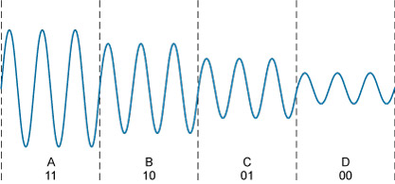
Multi level ASK
ASK can use multiple bits per signal element.

Slide 10
Frequency Shift Keying
The digital data stream changes the frequency of the carrier signal, f_{c}.
For example, a “1” could be represented by f₁=f_{c} +Δf, and a “0” could be represented by f₂=f_{c}-Δf.

Slide 11
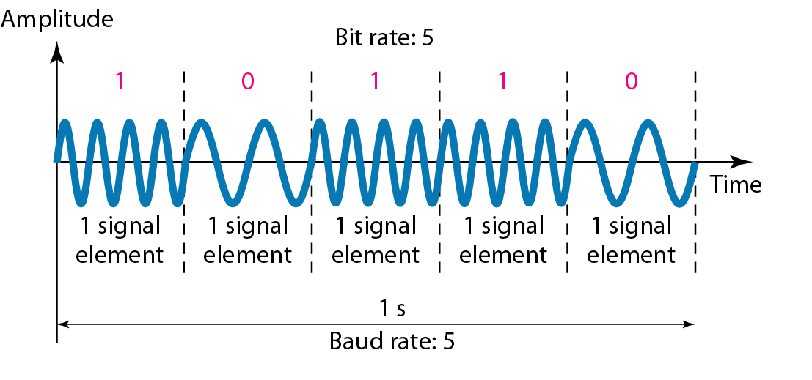
Figure 5.6 Binary frequency shift keying

Slide 12
Coherent and Non Coherent
In a non-coherent FSK scheme, when we change from one frequency to the other, we do not adhere to the current phase of the signal.
In coherent FSK, the switch from one frequency signal to the other only occurs at the same phase in the signal.

Slide 13
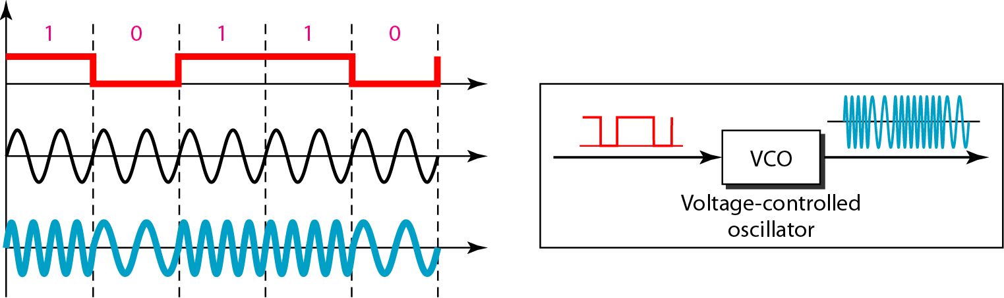
Figure 5.7 Bandwidth of MFSK used in Example 5.6

Slide 14
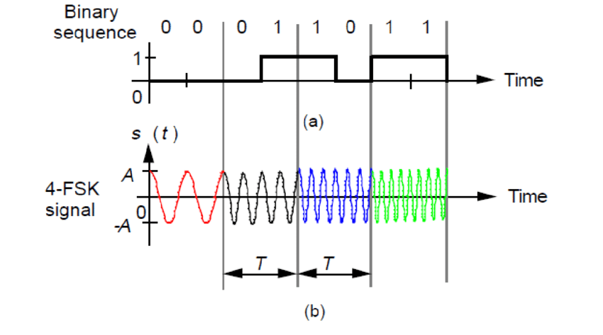
Multi level FSK
Like ASK, FSK can use multiple bits per signal element.

Slide 15
Phase Shift Keying
We vary the phase shift of the carrier signal to represent digital data.
PSK is much more robust than ASK as it is not that vulnerable to noise, which changes amplitude of the signal.

Slide 16
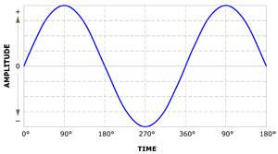
Figure 5.9 Phase shift keying

Slide 17
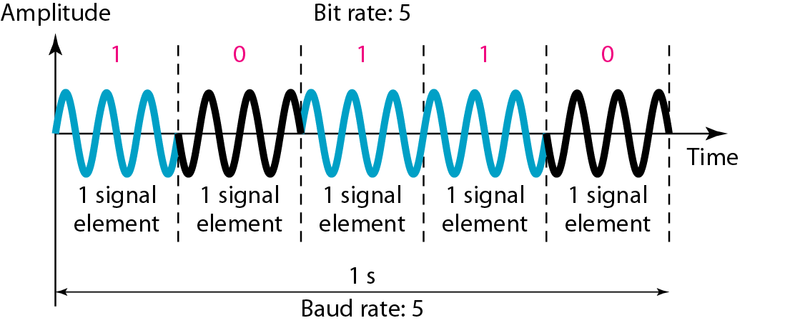
Figure 5.9 Binary phase shift keying

Slide 18
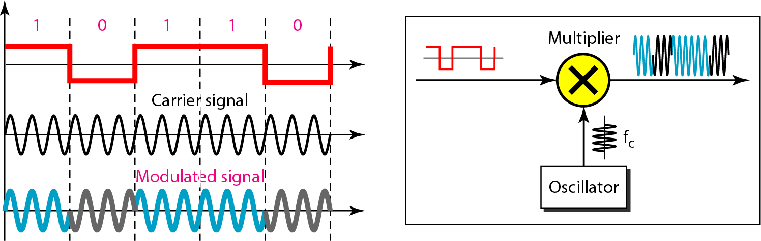
Figure 5.10 Implementation of BASK

Slide 19
Quadrature PSK
To increase the bit rate, we can code 2 or more bits onto one signal element.
In QPSK, we parallelize the bit stream so that every two incoming bits are split up and PSK a carrier frequency. One carrier frequency is phase shifted 90º from the other - in quadrature.
The two PSKed signals are then added to produce one of 4 signal elements. L = 4 here.

Slide 20
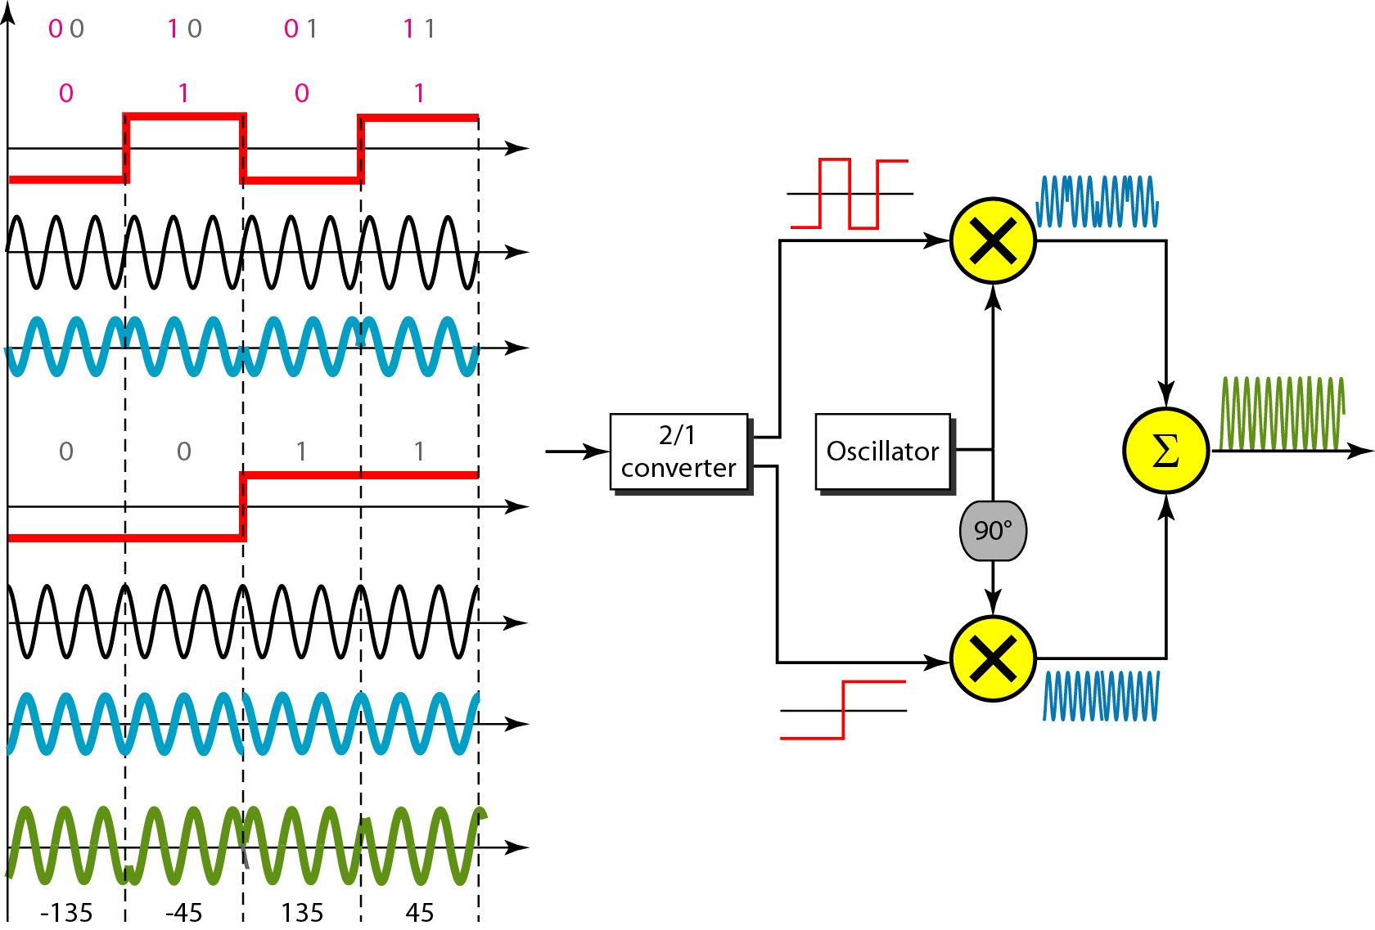
Figure 5.11 QPSK and its implementation

Slide 21
Constellation Diagrams
A constellation diagram helps us to define the amplitude and phase of a signal when we are using two carriers, one in quadrature of the other.
The X-axis represents the in-phase carrier and the Y-axis represents quadrature carrier.

Slide 22
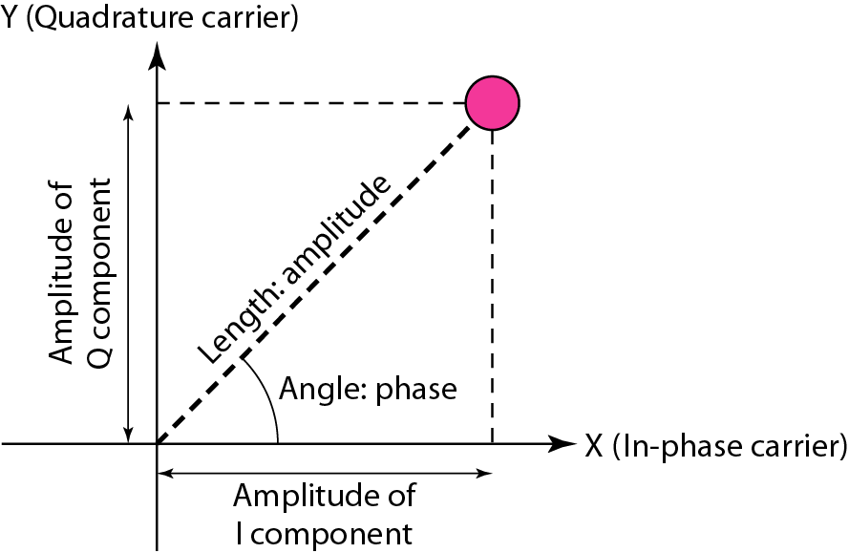
Figure 5.12 Concept of a constellation diagram

Slide 23
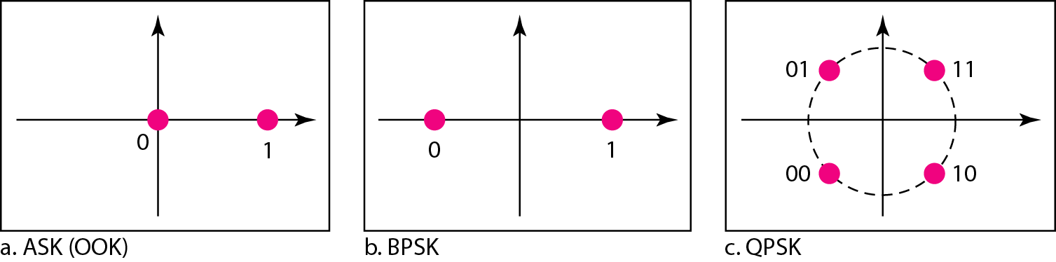
Example 5.8
Show the constellation diagrams for an ASK (OOK), BPSK, and QPSK signals.
Solution
Figure 5.13 shows the three constellation diagrams.

Slide 24
Figure 5.11 QPSK and its implementation

Slide 25
Quadrature Amplitude Modulation (QAM)
So far, we have been altering only one of the three characteristics of a sine wave at a time
what if we alter two?
combine ASK and PSK
Quadrature amplitude modulation is a combination of ASK and PSK
The advantages of QAM are higher data rates
However, combining three characteristics becomes complicated. So we usually do not use it.

Slide 26
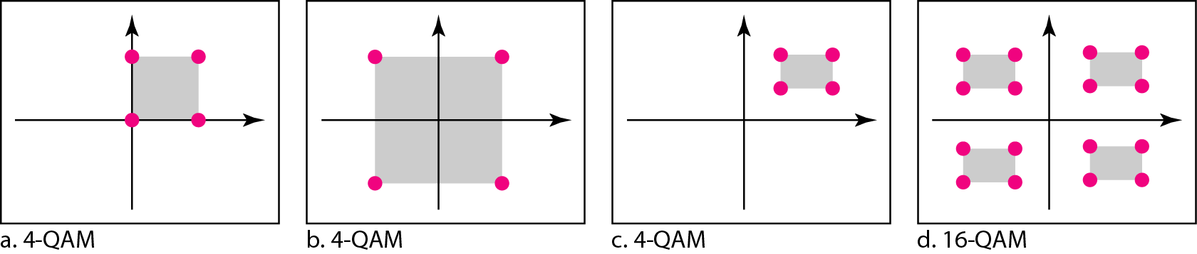
Figure 5.14 Constellation diagrams for some QAMs

